Slide 1
Functions

Slide 2
Functions
A function is a named sequence of statement(s) that performs a computation. It contains line of code(s) that are executed sequentially from top to bottom by Python interpreter. They are the most important building blocks for any software in Python.

Slide 3
Functions can be categorized as belonging to
Modules
Built in
User Defined

Slide 4
Module
A module is a file containing Python definitions (i.e. functions) and statements. Standard library of Python is extended as module(s) to a programmer. Definitions from the module can be used within the code of a program. To use these modules in the program, a programmer needs to import the module. Once you import a module, you can reference (use), any of its functions or variables in your code.
Ways to import a module in your program:
i. import
ii. from

Slide 5
Import
It is simplest and most common way to use modules in our code.
Its syntax is:
import modulename1 [,modulename2, ---------]
Example
>>> import math
On execution of this statement, Python will
search for the file “math.py”.
Create space where modules definition & variable will be created
Then execute the statements in the module.

Slide 6
Now the definitions of the module will become part of the code in which the module was imported.
To use/ access/invoke a function, you will specify the module name and name of the function- separated by dot (.). This format is also known as dot notation.
Example
>>> value= math.sqrt (25) # dot notation
The example uses sqrt( ) function of module math to calculate square root of the value provided in parenthesis, and returns the result which is inserted in the value. The expression (variable) written in parenthesis is known as argument (actual argument). It is common to say that the function takes arguments and return the result.

Slide 7
This statement invokes the sqrt ( ) function. We have already seen many function invoke statement(s), such as
>>> type ( )
>>> int ( ) , etc.

Slide 8
From Statement
It is used to get a specific function in the code instead of the complete module file. If we know beforehand which function(s), we will be needing, then we may use from. For modules having large no. of functions, it is recommended to use from instead of import.
Its syntax is
>>> from modulename import functionname [, functionname…..]
Example
>>> from math import sqrt
value = sqrt (25)

Slide 9
Here, we are importing sqrt function only, instead of the complete math module. Now sqrt( ) function will be directly referenced to. These two statements are equivalent to previous example.
from modulename import *
will import everything from the file

Slide 10
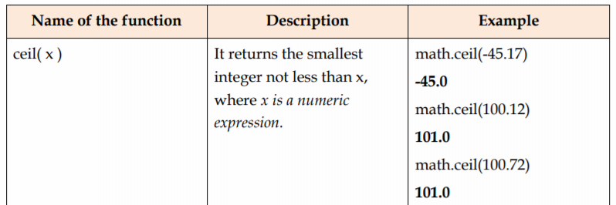
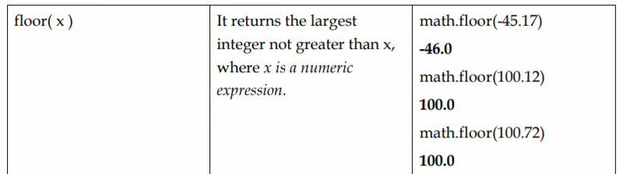
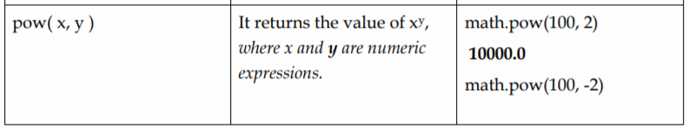
Some more functions available in math module:

Slide 11
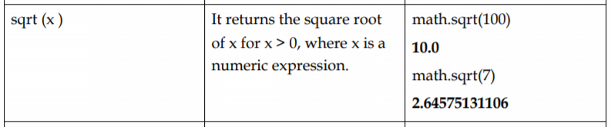

Slide 12
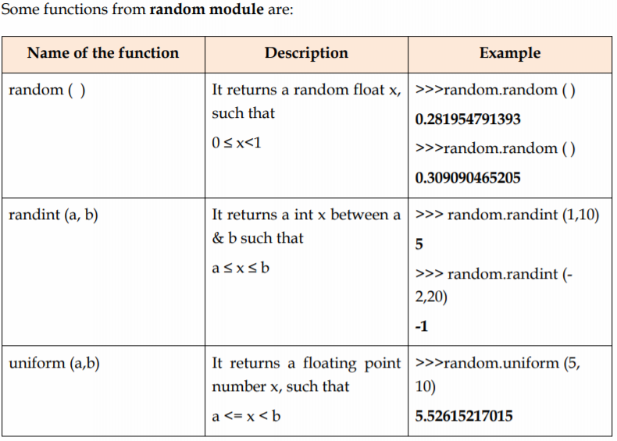
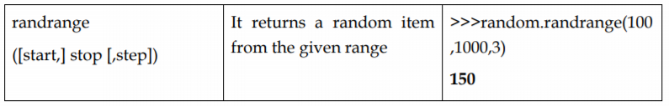

Slide 13
Built in Functions
Built in functions are the function(s) that are built into Python and can be accessed by a programmer. These are always available and for using them, you don’t have to import any module (file). Python has a small set of built-in functions as most of the functions have been partitioned to modules. This was done to keep core language precise

Slide 14
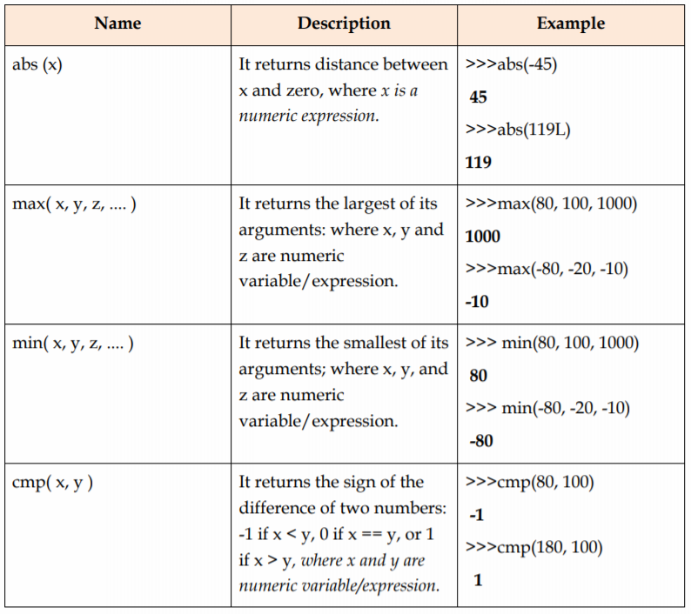

Slide 15
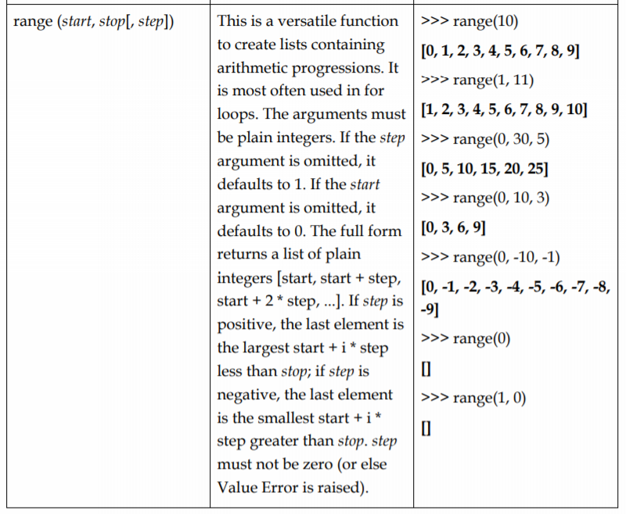

Slide 16
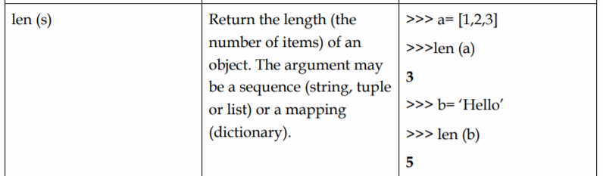
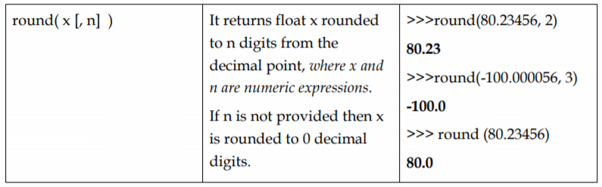

Slide 17
User Defined Functions
It is also possible for programmer to write their own function(s). These functions can then be combined to form a module which can then be used in other programs by importing them.
To define a function keyword def is used. After the keyword comes an identifier i.e. name of the function, followed by parenthesized list of parameters and the colon which ends up the line.
Next follows the block of statement(s) that are the part of function.

Slide 18
Block of statements
A block is one or more lines of code, grouped together so that they are treated as one big sequence of statements while executing. In Python, statements in a block are written with indentation. Usually, a block begins when a line is indented (by four spaces) and all the statements of the block should be at same indent level. A block within block begins when its first statement is indented by four space, i.e., in total eight spaces. To end a block, write the next statement with the same indentation before the block started.

Slide 19
The Syntax of function is:
def NAME ([PARAMETER1, PARAMETER2, …..]):
statement(s)
Example
def demo(): # Line No. 1
print(“Hello World”) #Line No. 2

Slide 20
The first line of function definition, i.e., Line No. 1 is called header and the rest, i.e. Line No. 2 in our example, is known as body.
Name of the function is demo, and empty parenthesis indicates no parameters.
Body of the function contains one Python statement, which displays a string constant on screen. So the general structure of any function is

Slide 21
Function Header
It begins with the keyword def and ends with colon and contains the function identification details. As it ends with colon, we can say that what follows next is, block of statements.
Function Body
Consisting of sequence of indented Python statement(s), to perform a task.
Defining a function will create a variable with same name, but does not generate any result. The body of the function gets executed only when the function is called/invoked. Function call contains the name of the function (being executed) followed by the list of values (i.e. arguments) in parenthesis. These arguments are assigned to parameters from LHS.

Slide 22
>>> demo () # Call/invoke statement of this function
It will produce following on screen
Hello World!

Slide 23
def is an executable statement. At the time of execution a function is created and a name (name of the function) is assigned to it. Because it is a statement, def can appear anywhere in the program. It can even be nested.
Example
def area (radius):
“”” calculates area of a circle.
require an integer or float value to calculate area.
returns the calculated value to calling function “””
a=radius**2
return a

Slide 24
The last statement of the function, i.e. return statement returns a value from the function. Return statement may contain a constant/literal, variable, expression or function, if return is used without anything, it will return None. In our example value of a variable area is returned.
Instead of writing two statements in the function, i.e.
a = radius **2
return a
We could have written
return radius **2
Here the function will first calculate and then return the value of the expression.

Slide 25
It is possible that a function might not return a value, as demo( ) was not returning a value. demo( ) prints a message on screen and does not contain a return statement, such functions are called void functions.

Slide 26
Example: whether a no is even or odd
def check (num):
if (num%2==0):
print “True”
else:
print “False”
>>> result = check (29)
False
>>> print (result)
None

Slide 27
Parameters
Parameters are the value(s) provided in the parenthesis when we write function header. These are the values required by function to work.
Arguments are the value(s) provided in function call/invoke statement. List of arguments should be supplied in same way as parameters are listed.

Slide 28
Scope of Variables
Scope of variable refers to the part of the program, where it is visible, i.e., area where you can refer (use) it. We can say that scope holds the current set of variables and their values
Global Scope
A variable, with global scope can be used anywhere in the program. It can be created by defining a variable outside the scope of any function/block.

Slide 29
Example
x=50
def test ( ):
print (“Inside test x is” , x)
print (“Value of x is” , x)
on execution the above code will produce
Inside test x is 50
Value of x is 50

Slide 30
Any modification to global is permanent and visible to all the functions written in the file.
Example
x=50
def test ( ):
x+= 10
print (“Inside test x is”, x)
print (“Value of x is”, x)
will produce
Inside test x is 60
Value of x is 60

Slide 31
Local Scope
A variable with local scope can be accessed only within the function/block that it is created in. When a variable is created inside the function/block, the variable becomes local to it. A local variable only exists while the function is executing

Slide 32
Example
X=50
def test ( ):
y = 20
print (“Value of x is “, X, “ y is “ , y)
print (“Value of x is “, X, “ y is “ , y)
On executing the code we will get
Value of x is 50 y is 20
The next print statement will produce an error, because the variable y is not accessible outside the function body.

Slide 33
A global variable remains global, till it is not recreated inside the function/block.
Example
x=50
def test ( ):
x=5
y=2
print (“Value of x & y inside the function are “ , x , y)
print (“Value of x outside the function is “ , x)
This code will produce following output:
Value of x & y inside the function are 5 2
Value of x outside the function is 50

Slide 34
If we want to refer to global variable inside the function then keyword global will be prefixed with it.
Example
x=50
def test ( ):
global x
x =2
y = 2
print (“Value of x & y inside the function are “ , x , y)
print (“Value of x outside function is “ , x)
This code will produce following output:
Value of x & y inside the function are 2 , 2
Value of x outside the function is 2

Slide 35
Function with Default parameters
It is possible to provide parameters of function with some default value. In case the user does not want to provide values (argument) for all of them at the time of calling, we can provide default argument values.
Example
def test (message, times=1):
print (message * times)
>>> greet (“Welcome”) # calling function with one argument value
>>> greet (“Hello”, 2) # calling function with both the argument values.
Will result in:
Welcome
HelloHello

Slide 36
Note:
The default value assigned to the parameter should be a constant only.
Only those parameters which are at the end of the list can be given default value. You cannot have a parameter on left with default argument value, without assigning default values to parameters lying on its right side.
The default value is evaluated only once, at the point of function definition

Slide 37
Function with keyword arguments
If there is a function with many parameters and we want to specify only some of them in function call, then value for such parameters can be provided by using their name, instead of the position (order)- this is called keyword arguments
def fun(a, b=1, c=5):
print (“a is “, a, “b is “, b, “c is “, c)

Slide 38
The function fun can be invoked in many ways
>>>fun (3)
a is 3 b is 1 c is 5
>>>fun (3, 7, 10)
a is 3 b is 7 c is 10
>>>fun (25, c = 20)
a is 25 b is 1 c is 20
>>>fun (c = 20, a = 10)
a is 10 b is 1 c is 20

Slide 39
1st and 2nd call to function is based on default argument value, and the 3rd and 4th call are using keyword arguments.
In the first usage, value 3 is passed on to a, b & c works with default values. In second call, all the three parameters get values in function call statement.
In third usage, variable a gets the first value 25, due to the position of the argument. And parameter c gets the value 20 due to naming, i.e., keyword arguments. The parameter b uses the default value.
In the fourth usage, we use keyword argument for all specified value, as we have specified the value for c before a; although a is defined before c in parameter list.

Slide 40
Note:
The function named fun ( ) have three parameters out of which first one is without default value and other two have default values. So any call to the function should have at least one argument.
While using keyword arguments, following should be kept in mind:
An argument list must have any positional arguments followed by any keywords arguments.
Keywords in argument list should be from the list of parameters name only.
No parameter should receive value more than once.
Parameter names corresponding to positional arguments cannot be used as keywords in the same calls.

Slide 41
Following calls to fun () would be invalid
fun () # required argument missing
fun (5, a=5, 6) # non keyword argument (6) following keyword argument
fun (6, a=5) # duplicate value for argument a
fun (d=5) # unknown parameter

